Slide 1
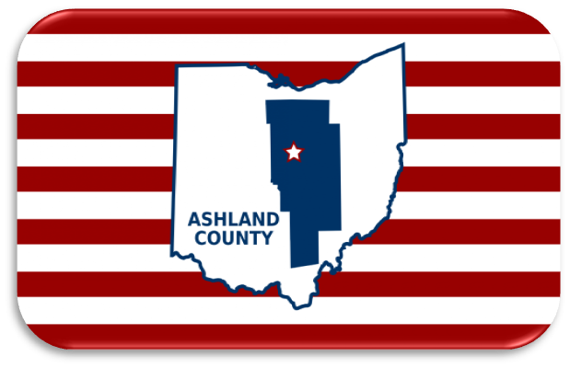

Ashland County 2024 Solar Eclipse Information

Slide 2
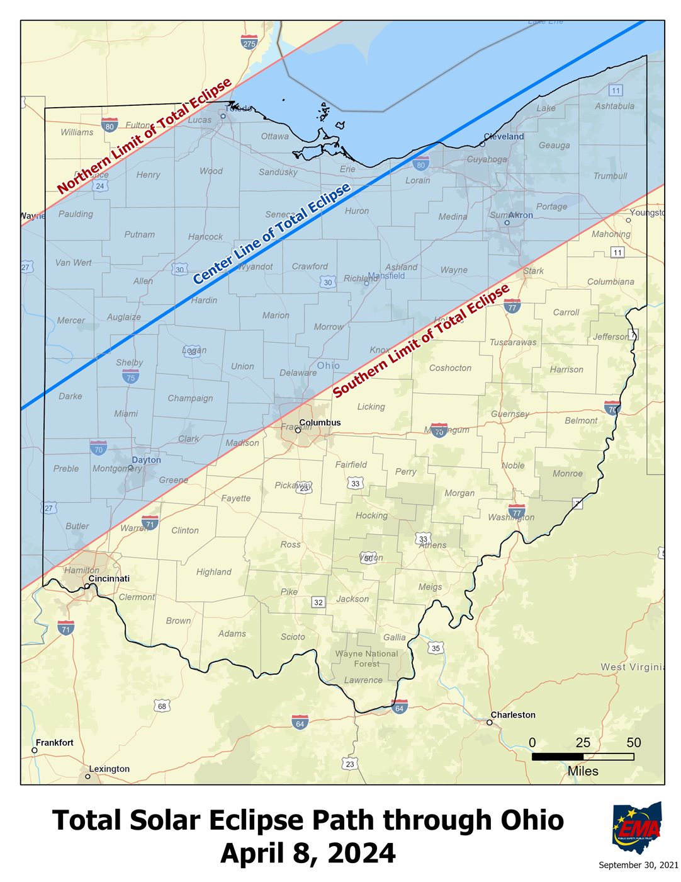
Path of the Eclipse in Ohio
Eclipse will travel across Ohio SW to NE
Totality begins in Greenville about 3:00 pm and exits near Avon Lake about 3:10 pm
2-4 minutes of totality
9 counties intersect the line of totality; 26 counties entirely within the area of totality.
Notes:
Will add more slides related to the eclipse

Slide 3
The Solar Eclipse comes to Ashland County
Possibility on 1 to 3 times our population of tourists to a county of 53,000 citizens.
Schools will be closed
Ashland University is open as scheduled

Slide 4
Overall Concerns
Local Tourism – Opportunities sold out (events, weekend packages, etc.)
Proximity to both Columbus and Cleveland opens opportunities for “day trips”
Inadequate road infrastructure for sudden surge especially on I 71 and US 30
Time of the year for tilling/planting (corn/soybean)

Slide 5
Visitors
Where to watch:
– Consider watching from your home
- Freer Field
- Ashland County Fairgrounds

Slide 6
Visitors
What to Expect
Up to 150,000 visitors
High volume of cell-phone and internet connectivity
Long lines at stores, gas stations
Lack of parking

Slide 7
Visitors
What to Bring to Prepare
Cell phone chargers and battery packs
First-aid/ medications
Cash (ATMs might not be available)
Flashlights and batteries
ISO 12312-2 Compliant eclipse glasses

Slide 8
Residents
How to Prepare
Consider watching from home
Have a 3-day supply of food and medicine on hand
Fill up any gas-powered machines and generators
Reschedule any appointments for after the eclipse

Slide 9
Residents
The Day of:
Expect roadways and businesses to either be busy or closed due to the increased population
Large crowds will be in several places especially those selected viewing areas
If in public have a meeting place established to connect with family if separated

Slide 10
Businesses
What to expect:
Expect more foot traffic and increased sales
Supply chain issues could arise
Phone and credit card lines will be stressed
Safety precautions will be important: security, limit of customers at one time

Slide 11
Businesses
How to Prepare
Adjust schedules for traffic
Consider how employees can get to and from work
Stock essential supplies
Prepare for emergencies
Consider closing if services and products are not essential

Slide 12
Public Health Concerns
Local inventory for basic needs: food, medicine, gasoline, heating fuel
Surge in temporary permits for campgrounds, food, tattoo, etc. and illegal operations of these
Surge in overdose events
Post damage to HSTS and wells and crisis on replacement/repair
Ability of staff to report to work

Slide 13
Law Enforcement Concerns
Traffic & Parking
  Traffic will be heavy and congested near US, State, and Interstate routes on 4-8-24
  Consider not driving on 4-8-24
  Do not block driveways
  Park only where Permitted

Slide 14
Emergency Management
https://ema.ohio.gov/media-publications/ohio-total-solar-eclipse
https://ema.ohio.gov/media-publications/ohio-total-solar-eclipse

Slide 15
Medical Facilities
Walk in Urgent Care 1016 Sugarbush Dr.
UH Urgent Care 663 E. Main St.
Minute Clinic 418 E. Main St.
UH Samaritan 1025 Center St.
Ohio Health 1720 Ohiohealth Way
Hospitals will be operating “business as usual”

Slide 16
FAQ
Where to find more information
  https://ashlandoh.com/
  https://www.ashlandmainstreet.org/
  https://www.ashland-ohio.com/
  https://www.ashlandcountyoh.us/county-services/homeland-security-and-emergency-management-agency

Slide 17
Chamber Information
https://ashlandoh.com/

