Slide 1

2024 solid waste district update
January 9, 2025

Slide 2
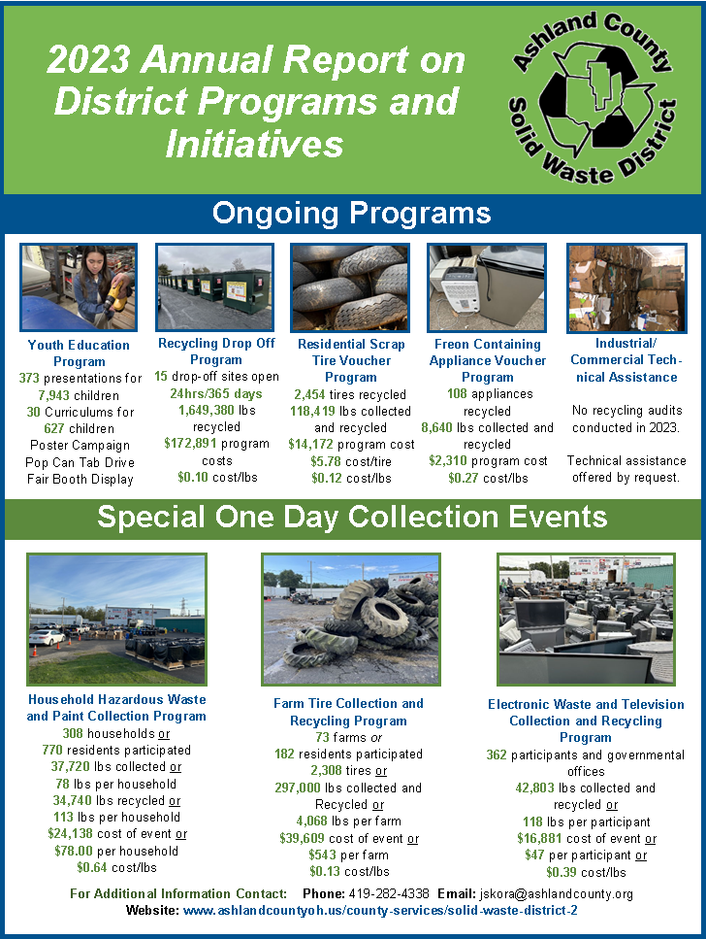
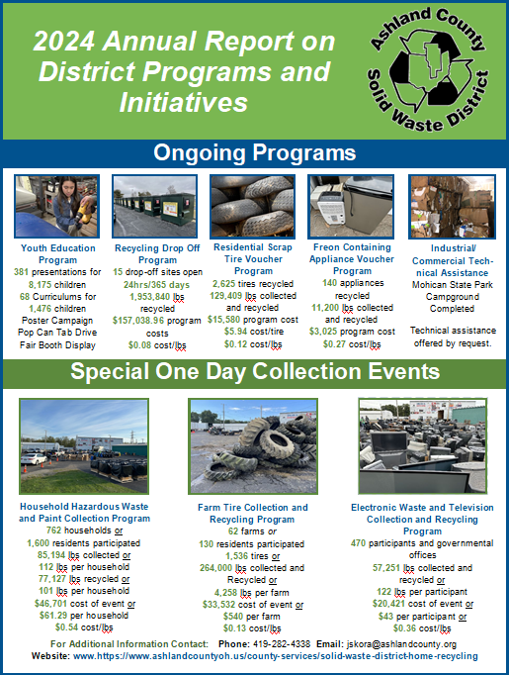
Key metrics on web site for 2023 and 2024

Slide 3
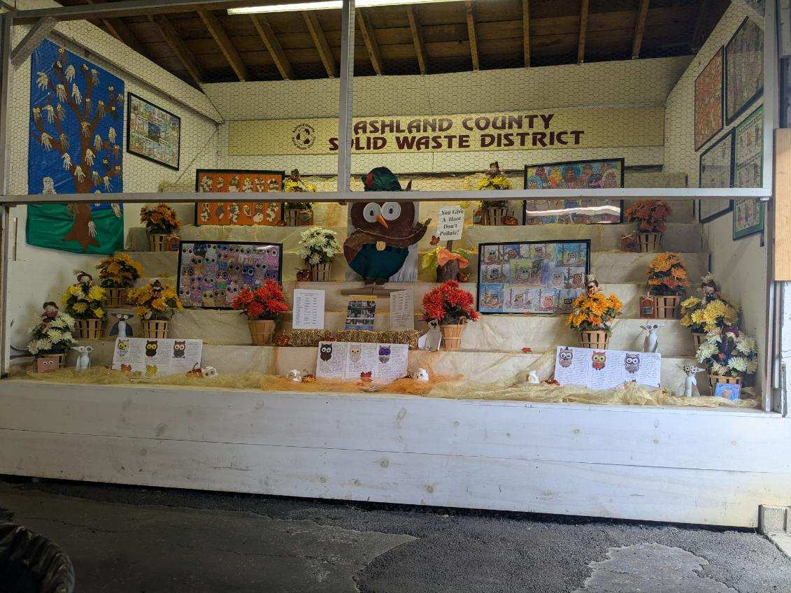
2024 youth education program
381 presentations for
8,175 children
68 Curriculums for
1,476 children
Poster Campaign
Pop Can Tab Drive
Fair Booth Display

Slide 4
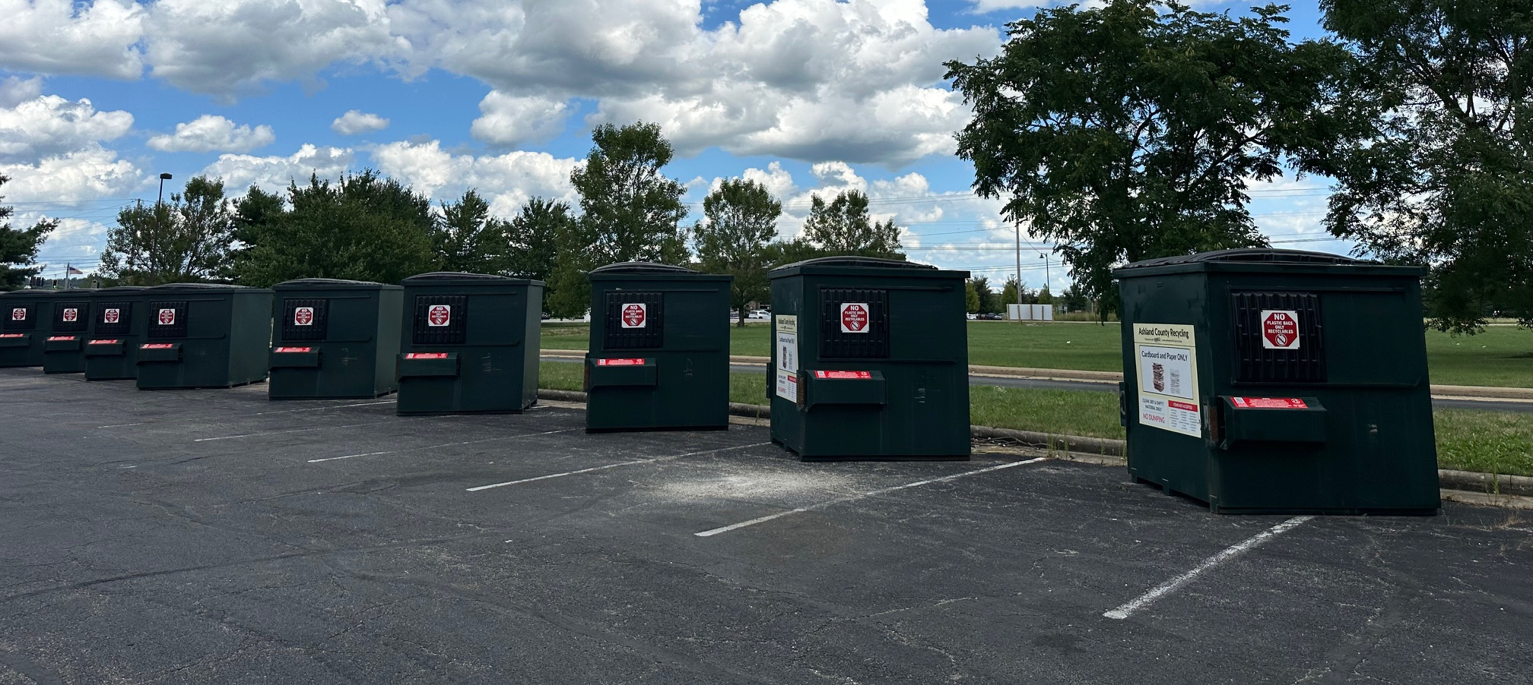
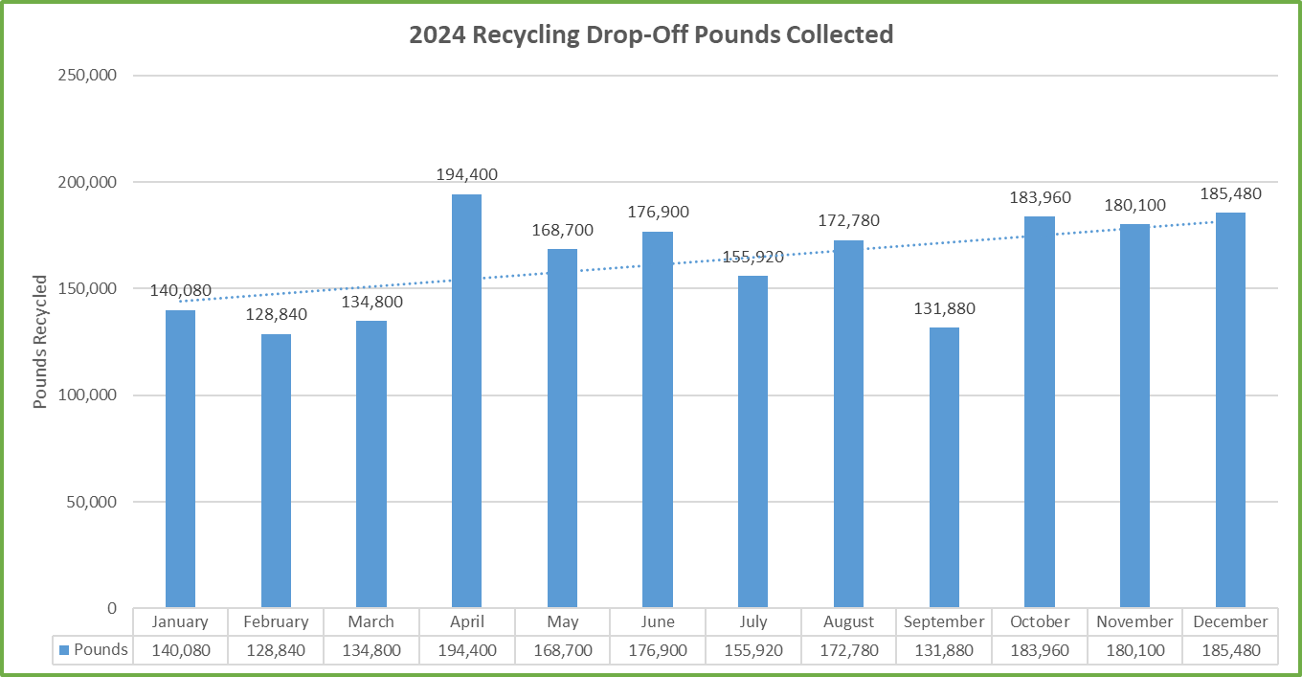
2024 recycling drop-off program
15 drop-off sites open
24hrs/365 days
1,953,840 lbs
recycled
$157,038 program costs
$0.08 cost/lbs
Up 304,460 lbs over 2023

Slide 5
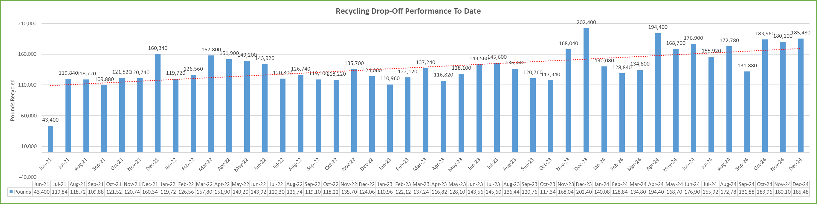
2024 recycling drop-off program

Slide 6
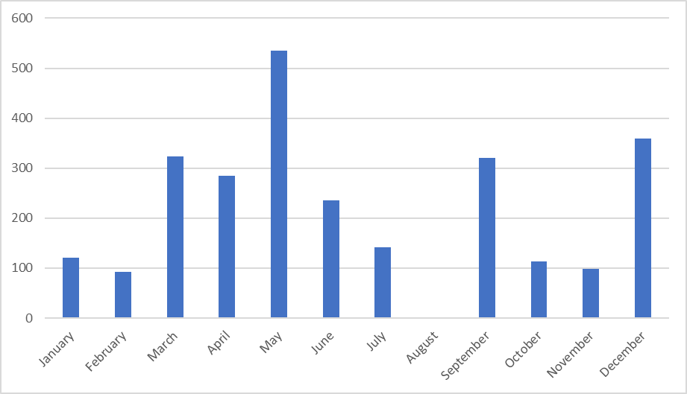
2024 residential scrap tire voucher program
2,625 tires recycled
129,409 lbs collected and recycled
$15,580 program cost
$5.94 cost/tire
$0.12 cost/lbs
Up 10,990 lbs over 2023

Slide 7
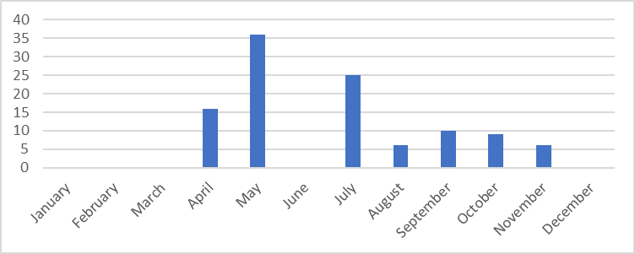
2024 residential freon appliance voucher program
140 appliances
recycled
11,200 lbs collected and recycled
$3,025 program cost
$0.27 cost/lbs
Up 2,560 lbs over 2023

Slide 8
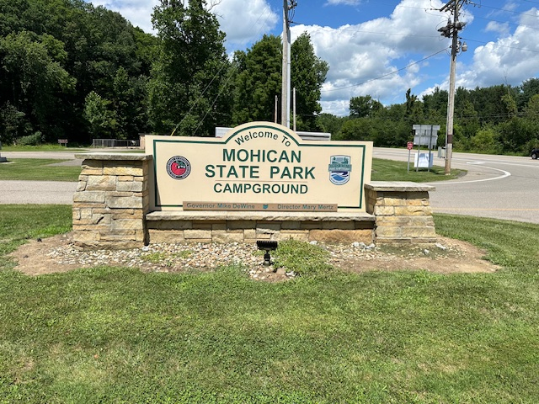
2024 industrial/commercial technical assistance
Industrial/Commercial Technical Assistance
Conducted Audit of Mohican State Park Campground.
Technical assistance offered by request.

Slide 9
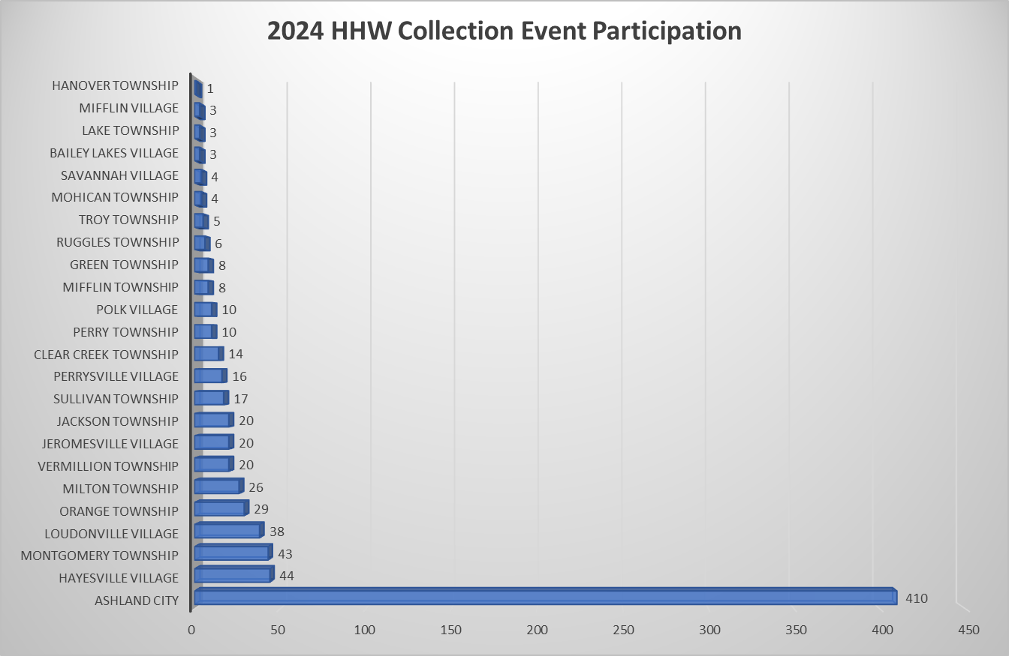
2024 household hazardous waste
762 households or
1,600 residents participated
85,194 lbs collected or
112 lbs per household
77,127 lbs recycled or
101 lbs per household
$46,701 cost of event or
$61.29 per household
$0.54 cost/lbs
Up 47,474 lbs over 2023
and 454 Cars

Slide 10
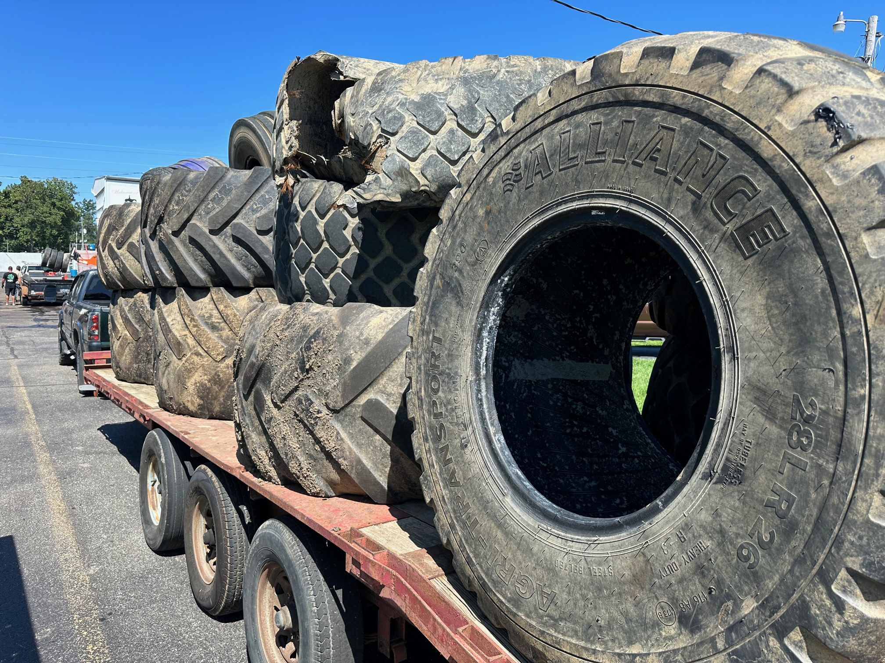
2024 farm tire collection
62 farms or
130 residents participated
1,536 tires or
264,000 lbs collected and
Recycled or
4,258 lbs per farm
$33,532 cost of event or
$540 per farm
$0.13 cost/lbs

Slide 11
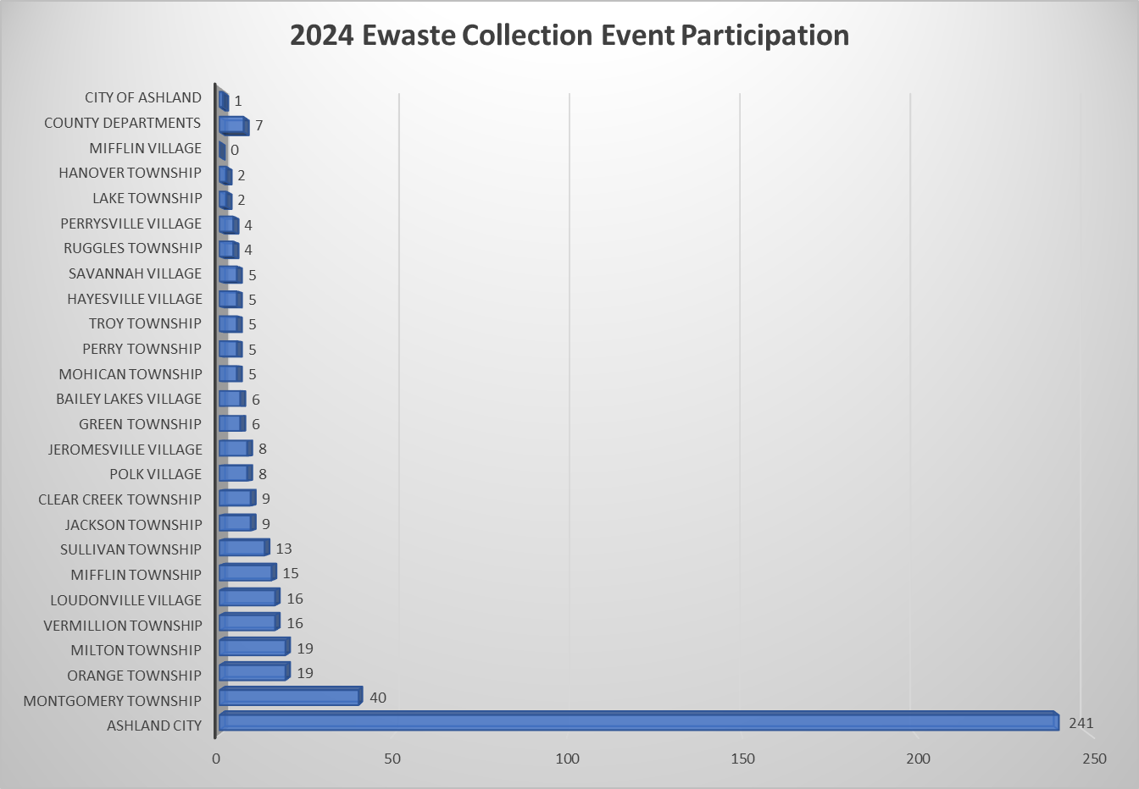
2024 E-Waste and TV collection
470 participants
57,251 lbs collected and
recycled or
122 lbs per participant
$20,421 cost of event or
$43 per participant or
$0.36 cost/lbs
Up 14,448 lbs over 2023
and 108 Cars

Slide 12
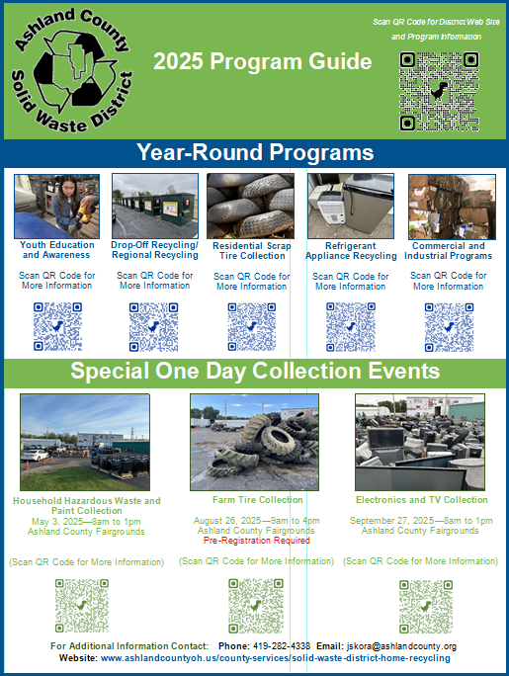
2025 mailer to all residents
HHW and Ewaste
Advertising Effects
HHW Ewaste
Flyers 44% 35%
Facebook 19% 26%
Newspaper 24% 22%
Web Site 12% 17%

Slide 13
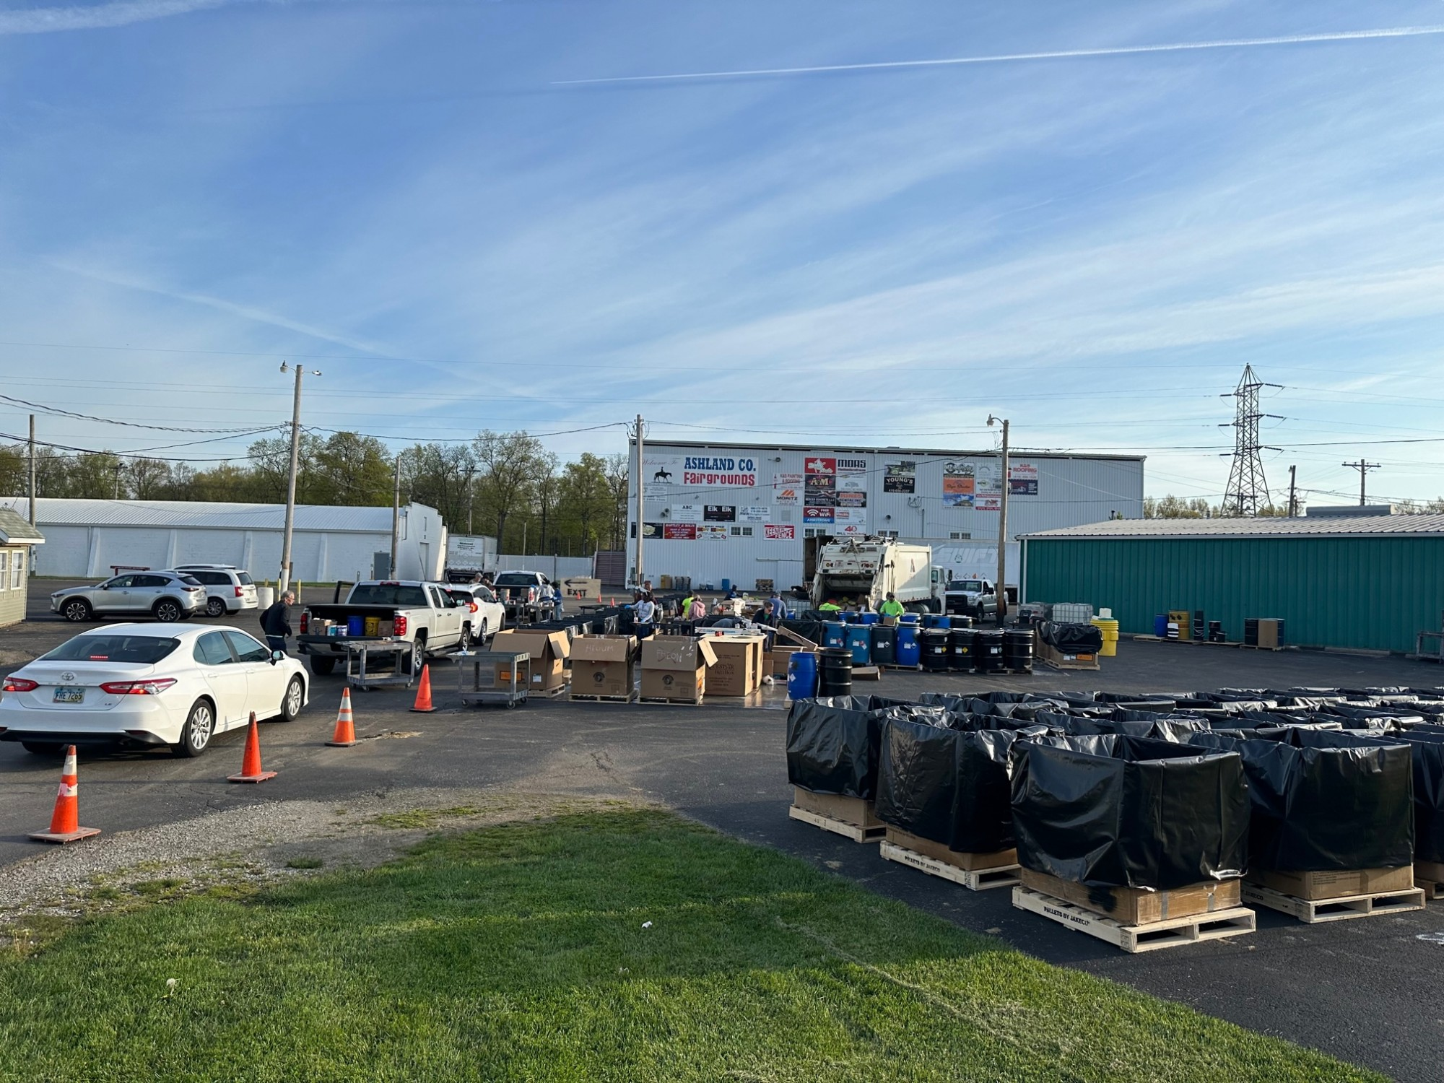
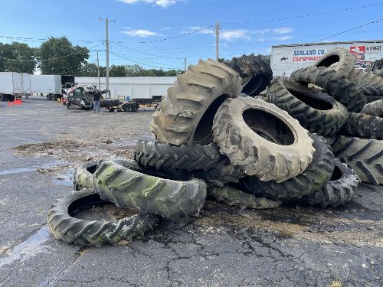
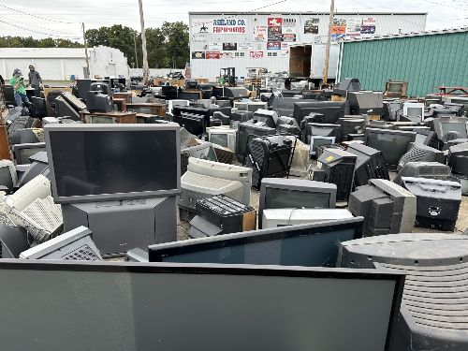
2025 Special collection events
Household Hazardous Waste and Paint Collection Program
May 3, 2025
Farm Tire Collection and Recycling Program
August 26, 2025
Electronic Waste and Television Collection and Recycling Program
September 27, 2025

Slide 14
New solid waste plan update

Slide 15
New solid waste plan update
Ashland County Solid Waste Management District Solid Waste Management Plan Update Schedule
Draft Plan Resolution from Policy Committee | July 2023 | August 2023 | August 3, 2023 | 100%
Ohio EPA 45-Day Comment Period | August 17, 2023 | October 2, 2023 |  | 100%
Revise Plan Based on NBO Comments | October 2023 | April 2024 |  | 100%
Meet with OEPA to Review Changes | April 2024 | April 2024 |  | 100%
Public Comment Period | May 1, 2024 | May 30, 2024 |  | 100%
Public Hearing | June 6, 2024 | June 6, 2024 |  | 100%
Revise Plan Based on Public Comments | June 6, 2024 | June 6, 2024 |  | 100%
Policy Committee Adopts Draft Plan | June 6, 2024 | June 6, 2024 | June 6, 2024 | 100%
Ratification (90 Days) | July 1, 2024 | September 28, 2024 |  | 100%
Policy Committee Certifies Ratification | October 2024 | October 2024 | October 3, 2024 | 100%
Final Ohio EPA Review (90 Days) | October 17, 2024 | January 8, 2025 |  | 100%
Plan Approval | 2/20/2025

